Slide 1


Predicting rains in Australia using Machine Learning models
Team : Random forest

Slide 2
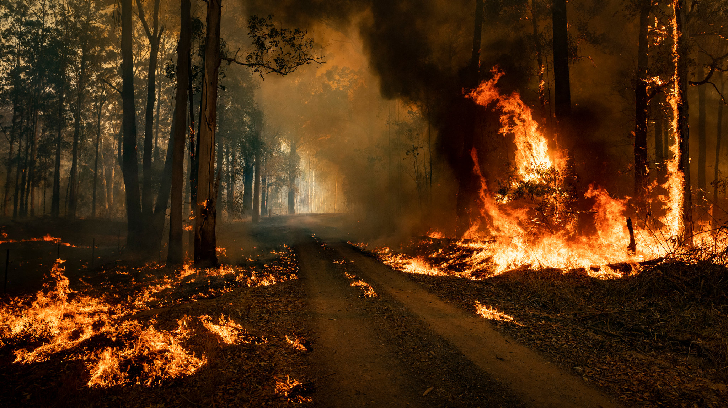
What & Why?
85% Australians live within 50km of coast.
Extreme weather conditions – floods and forest fires.
Impact – increase in shoreline erosion (agriculture).
Result – affecting millions of people and loss of billions of dollars.

Slide 3

Target?
Dataset - 10 years of daily weather observations from many locations across Australia
Target variable – RainTomorrow (binary variable, Yes if the rain for that day was 1mm or more)
Predict next-day rain by training classification models on the target variable.
Perform EDA(Exploratory Data Analysis) for data preprocessing and feature engineering.
Train ML models and evaluate for predictions.
Source - https://www.kaggle.com/datasets/jsphyg/weather-dataset-rattle-package

Slide 5
Exploratory Data Analysis
Removing Null Values
Records where DV = NA.
Dropping columns with records having NA >= 50%.
Normalization
Replacing NA with mean (Numerical Columns).
Replacing NA with mode (Categorical Column).
DATA
PRE-PROCESSING
Correlation
Dropping Temp3pm since it has correlation of 0.97 with Maxtemp and its removal improves accuracy.
Reducing Cardinality
Date variable has 3436 unique values.
Considering only the month and day part of the date variable.

Slide 6
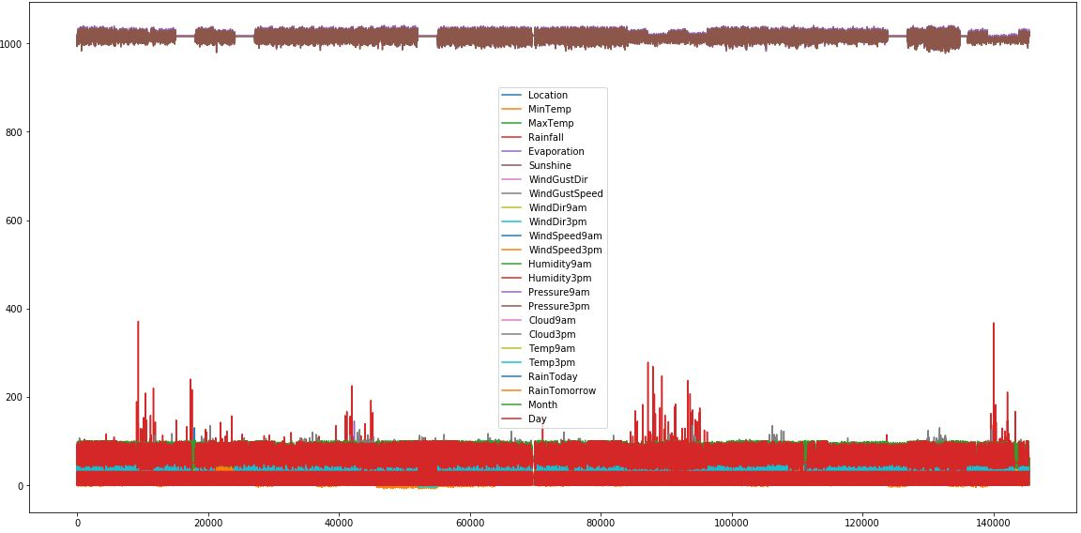
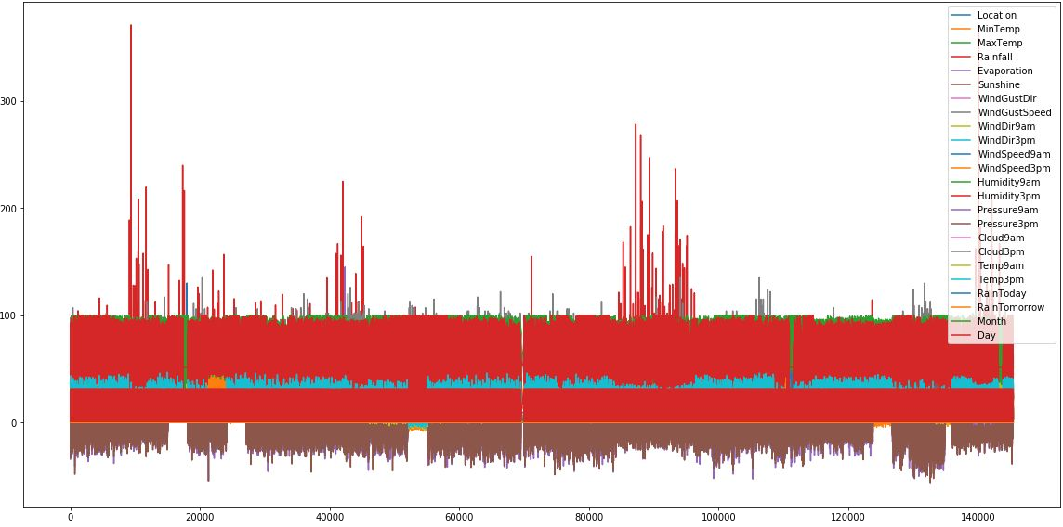
Exploratory Data Analysis
Noticed - all other columns have values that are in close range, the values of Pressure9am and Pressure3pm are much higher.
Used z-score to normalize these columns and then multiplied it by 10. The new range observed was closely - (-55, 35) which brings it quite close to other columns’ values.
Feature Engineering - Plotting the graph for all the values

Slide 7
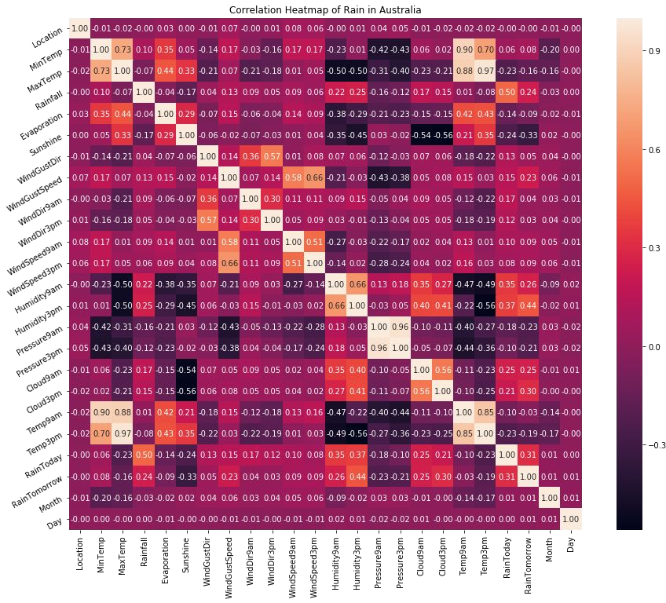
Exploratory Data Analysis
Insights from Correlation HeatMap:
MaxTemp and Temp3pm R- 0.97
MinTemp and Temp9am R - 0.90
MaxTemp and Temp9am R - 0.88
Location and RainTomorrow had no correlation - 0.0
Due to the first point of MaxTemp and Temp3pm having an extremely high correlationTemp3pm was dropped and no more considered. On experimenting with this - a small improvement in our ML model was observed

Slide 8
Best Model?

Slide 9
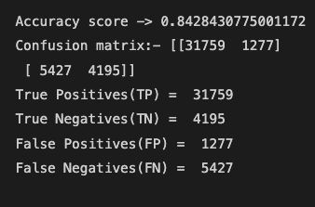
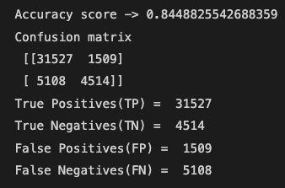






Model Comparison
KNN k=10
Random Forest

Slide 10
What did we find?
With varying probabilities, it is always difficult to precisely predict rainy days.
Despite that, based on historic data- algorithms can give accuracy of over 85% considering the preprocessing.
Efficiency can further be improved if outliers are worked upon.
Business use case?
Weather prediction has an impactful effect on disaster management
Agricultural decisions can be taken wisely
Cricket ground selections

Slide 11





Team Members:
Data preprocessing
Algorithm Modeling
Algorithm Modeling
Data preprocessing
Evaluation

Slide 12

Have a colorful day ahead. Thankyou!

